Slide 1

Machine Learning Final Project Presentation
Project Topic:
Emoji Generation Through Facial Emotion and Text Sentiment Analysis

Slide 2

Introduction
Name: K.M.Tahlil Mahfuz Faruk
Student ID: 200042158
Name: Dayan Ahmed Khan
Student ID: 200042105
Name: Sadman Sakib Shoumik
Student ID: 200042144

Slide 3

Overview
Facial Emotion Detection
Text Sentiment Analysis
Match Facial Emotion and Text Sentiment
Generation of Emoji based on the matching results

Slide 4

Dataset Analysis
Facial Emotion Detection
Represents Seven Individual Emotions
Text Sentiment Detection
Represents Five Individual Emotions

Slide 5
Model Analysis
Facial Emotion Detection
Convolutional Neural Network(CNN)
Text Sentiment Detection
Recurrent Neural Network(RNN)
Bi-directional Long Short Time Memory(BiLSTM)

Slide 6

Contribution
Facial Emotion Detection:
K.M.Tahlil Mahfuz Faruk(200042158)
Text Sentiment Detection:
Dayan Ahmed Khan(200042105)
Emoji Generation:
Shadman Sakib Shoumik (200042144)

Slide 7
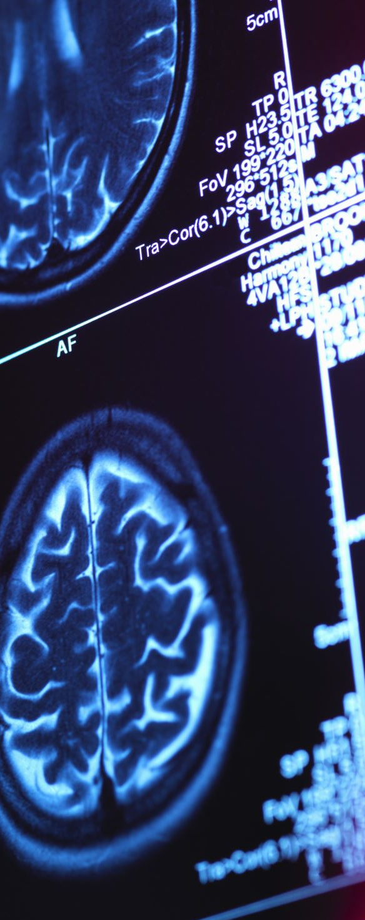
Facial Emotion Detection(CNN Model)
Architecture: Convolutional Neural Network(CNN)
Data Preprocessing: Resized to 48x48 pixels
Epoch: 100 (44 performed)
Batch Size: 128
Kernel Size: 3x3
Pooling: Max Pooling with pool size 2x2
Dropout Rate
Helps with regularization
Convolutional Layer : 0.4
Dense Layer: 0.3
Optimizer: Adaptive learning rate(Adam)
Activation Functions: ReLU and Softmax

Slide 8
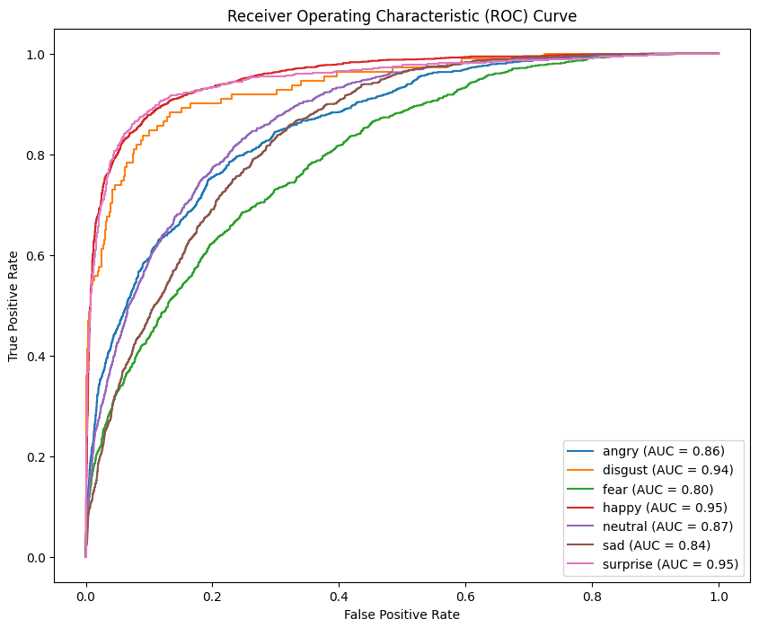
Facial Emotion Detection Model ROC And AUC Analysis

Slide 9
Text Sentiment Detection(RNN Model)
Architecture: Bi-directional Long Short Time Memory

Slide 10
Emoji Generation

